Slide 1
GRANDES
INVENTOS EN EL MUNDO
1750 - 1900

Slide 2


Slide 3
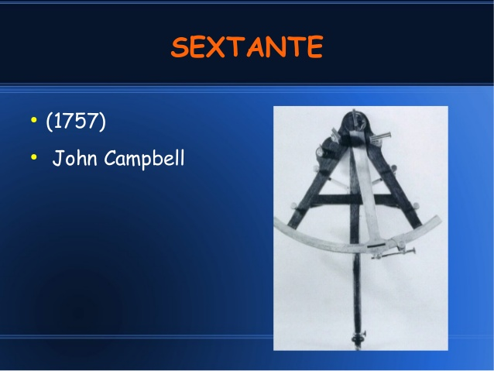

Slide 4


Slide 5
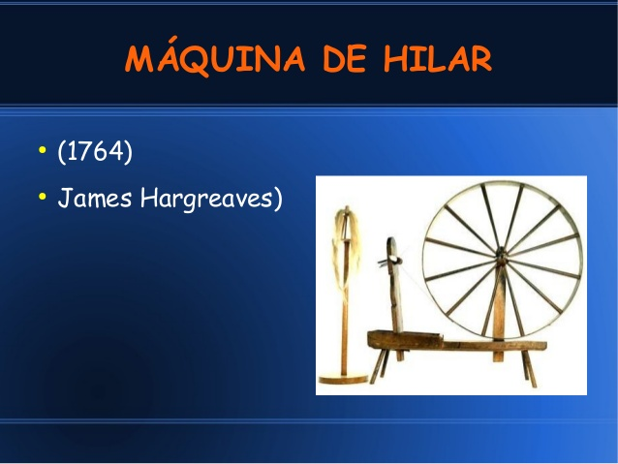

Slide 6
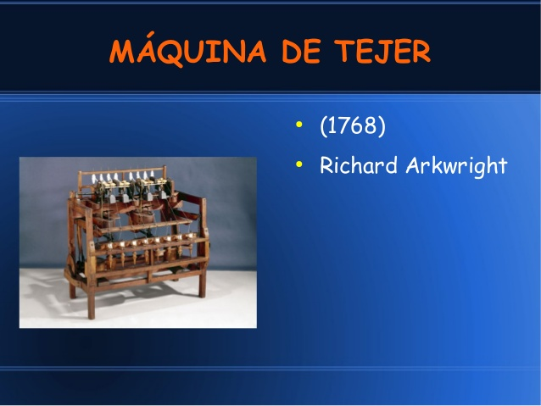

Slide 7
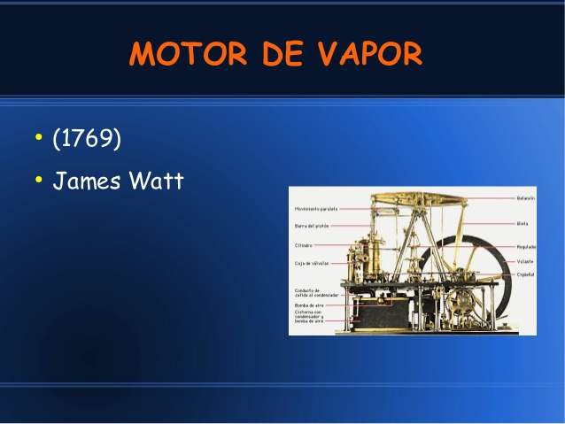

Slide 8
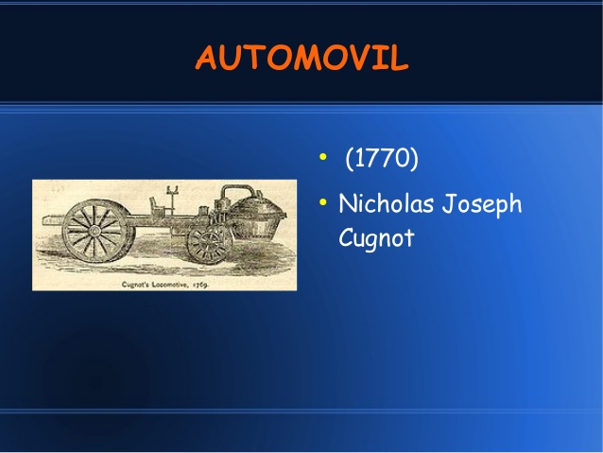

Slide 9


Slide 10


Slide 11
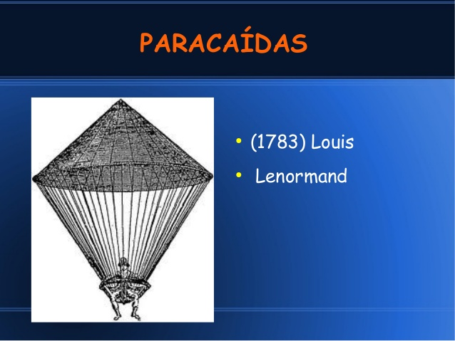

Slide 12
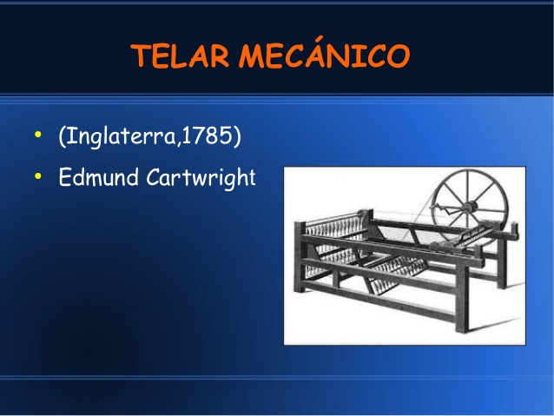

Slide 13
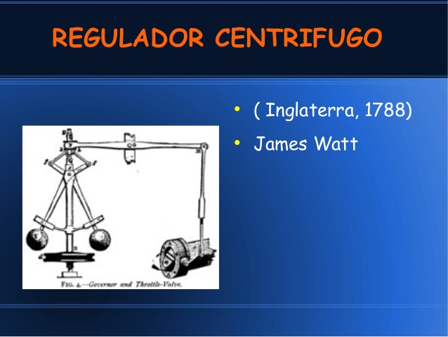

Slide 14
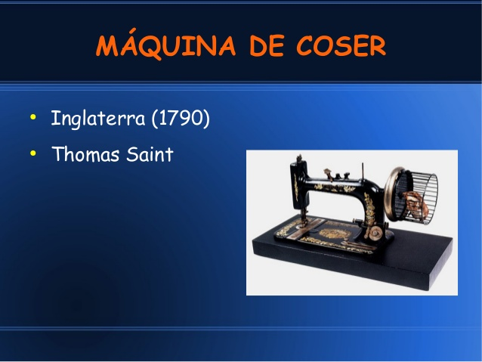

Slide 15


Slide 16
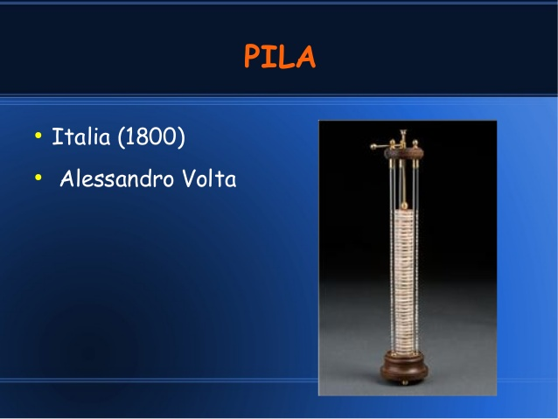

Slide 17
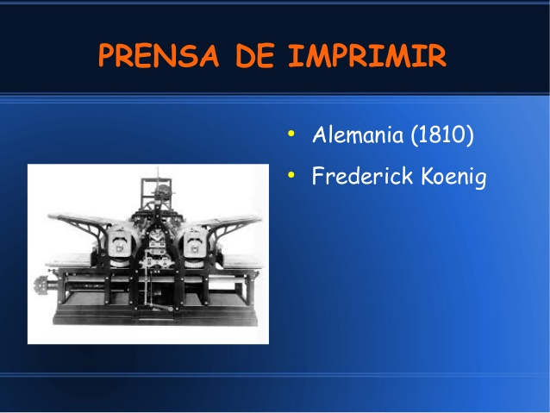

Slide 18


Slide 19


Slide 20
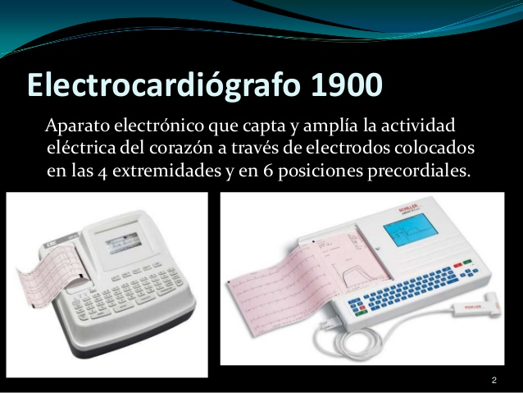

Slide 21
VIDEOS
https://www.sutori.com/story/inventos-de-los-siglos-xviii-xix--6LTcVcERs497w4BsgAkjJ3dy
https://www.youtube.com/watch?v=xvKYmjuHGck

